Slide 1
Market Timing Practice 9
Miguel Ángel González Álvarez
Emilly Noelia Villacís Recalde
Quinten Woumans
Edoardo Anfelli
Stokely Ross

Slide 2
Takeaways
Both, the risk parity and the equally weighted portfolio, outperform the first 100 days of the period in the remaining 150 days.
The benchmark passive approach provided stable returns with lower volatility, outperforming most active strategies
The RSI strategy, with its momentum-based focus, managed to capture returns without large drawdowns and was the most successful among active strategies
The presence of transaction costs punished more volatility-sensitive strategies.

Slide 3
Table of contents
Risk Parity Portfolio VS
Equally Weighted Portfolio
01
02
Market Timing Strategies
Days 1 to 100 VS Days 101 to 250
SMA VS MACD VS RSI VS GI

Slide 4
01
Risk Parity Portfolio VS
Equally Weighted Portfolio
Days 1 to 100 VS Days 101 to 250

Slide 5
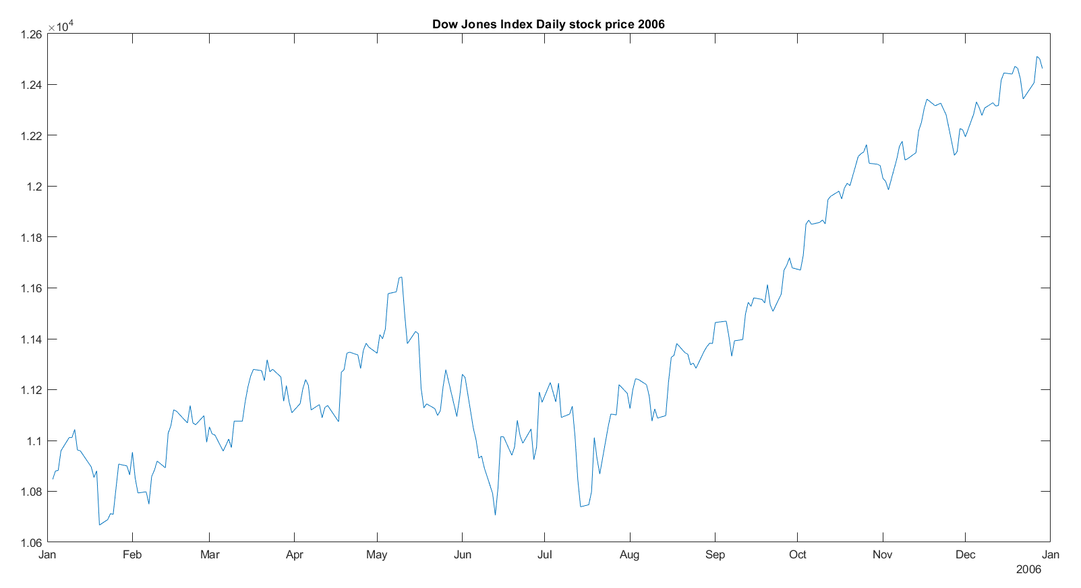
Dow Jones Industrial Average Index daily price 2006

Slide 6
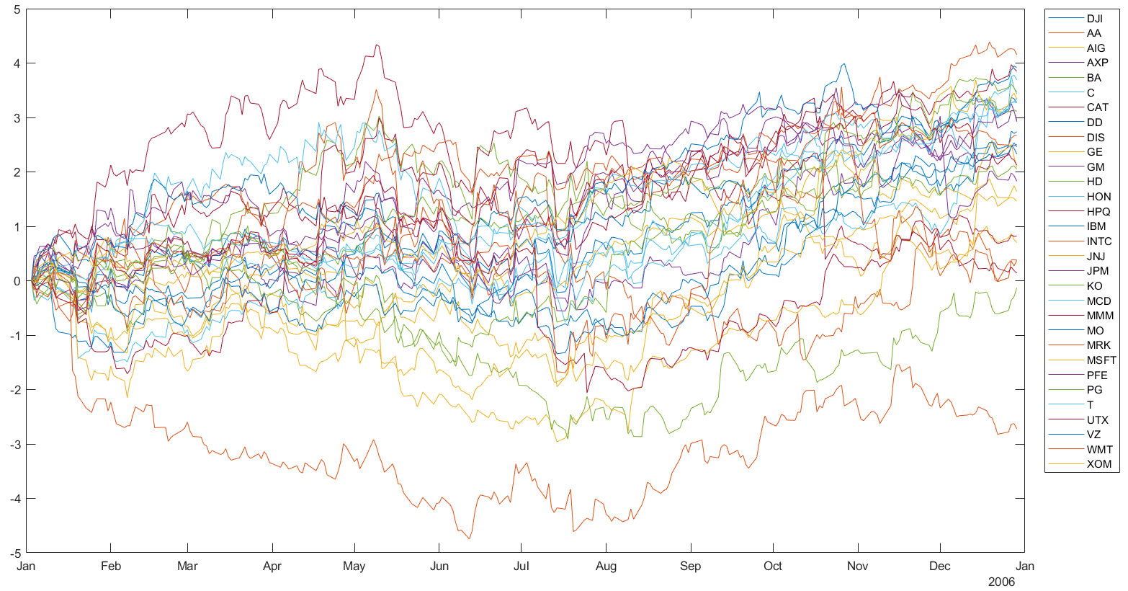
Dow Jones Industrial Average Stocks daily price 2006

Slide 7
Sampling and Asset Allocation Methods
Sampling:
Training sample ← First 100 days of the trading year
Testing sample ← Remaining 150 days of the trading year
Asset allocation methods:
Hierarchical Risk-parity portfolio (6 clusters)
Equally-weighted portfolio (3,33% to every asset)

Slide 8

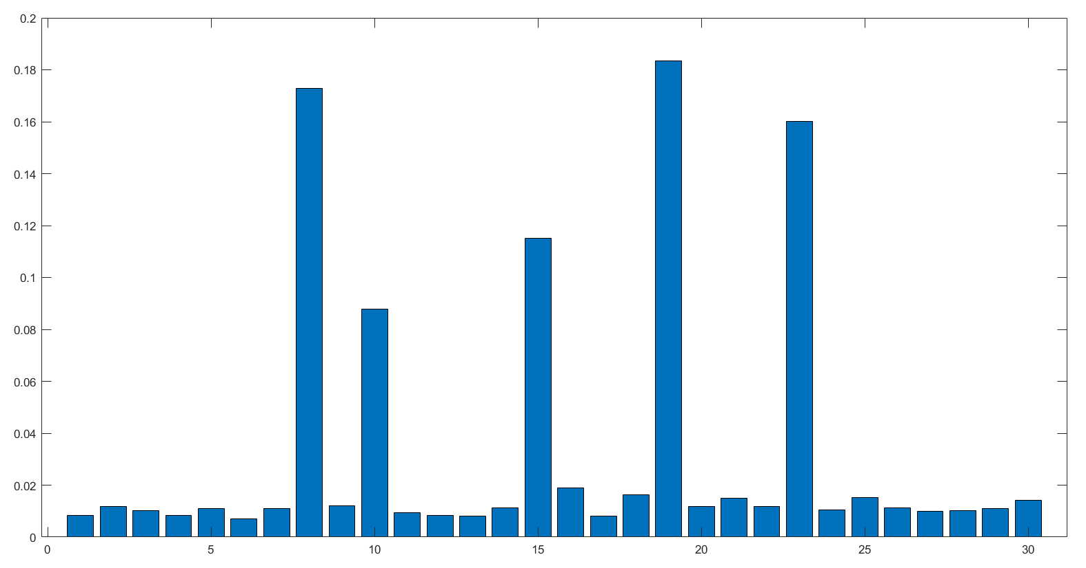




First 100 days’ Risk Parity Portfolio Weights
17,3%
8,8%
11,5%
18,3%
16%%

Slide 9
Risk-adjusted returns improve in the testing sample
 | Days 1 to 100 |  | Days 101 to 250
 | Risk | Return | Risk | Return
Risk Parity | 0,68% | 0,0313% | 0,69% | 0,0948%
Equally Weighted | 0,60% | 0,0576% | 0,56% | 0,0796%

Slide 10
Both portfolios outperform the training sample
in the testing sample
 | Days 1 to 100 |  | Days 101 to 250
 | Sharpe Ratio | p-value | Sharpe Ratio | p-value
Risk Parity | 0,046 | 0,64854 | 0,138 | 0,09306
Equally Weighted | 0,096 | 0,33915 | 0,143 | 0,08198
 | Days 1 to 100 | Days 101 to 250
Target p-value | 0,01 | 0,00667
Not enough statistical evidence to prove that the Sharpe Ratios are different from 0.
⇒

Slide 11
02
Market Timing Strategies
SMA VS MACD VS RSI VS GI

Slide 12
Strategy
Select 5 Dow Jones Industrial component stocks
Build Signal Tables for market timing strategies
Simple Moving Average (SMA)
Moving Average Convergence/Divergence (MACD)
Relative Strength Index (RSI)
Goodness Indicator (GI)
Transaction costs: fee of 0.25% per transaction
Analyze strategy performance

Slide 13
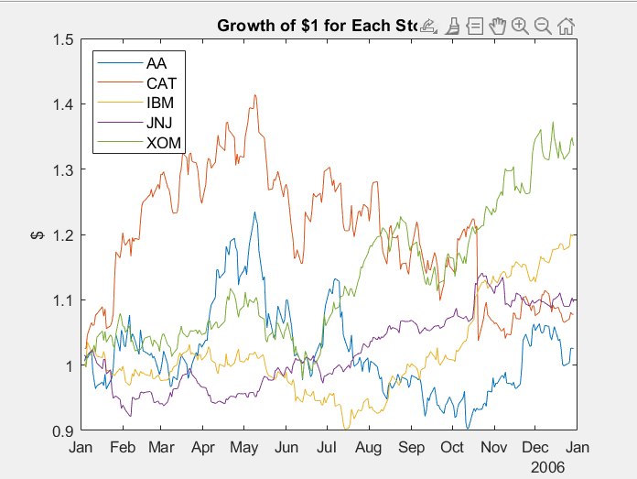
5 DJI Stocks
AA - Alcoa Corporation
CAT - Caterpillar Inc.
IBM - International Business Machines Corporation
JNJ - Johnson & Johnson
XOM - Exxon Mobil Coporation

Slide 14
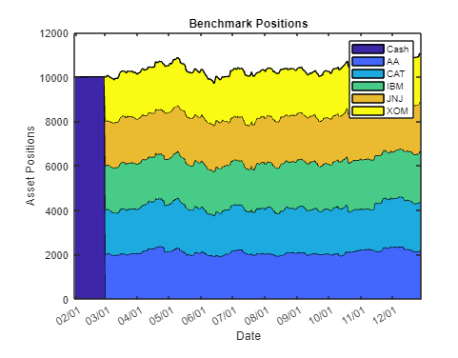
Equal-weighted strategy (Benchmark)
In an equal-weighted strategy, each stock initially receives the same allocation, ensuring a balanced distribution across the assets regardless of individual stock performance.

Slide 15
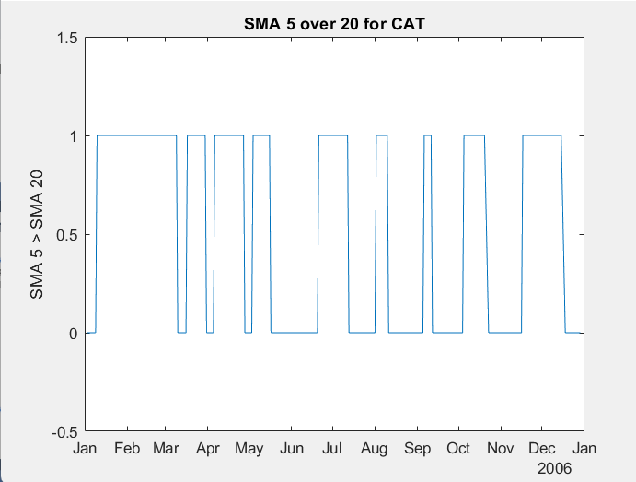
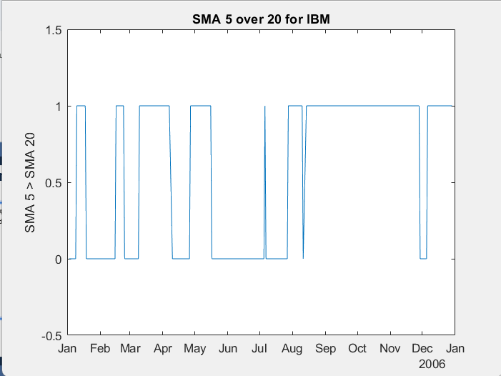
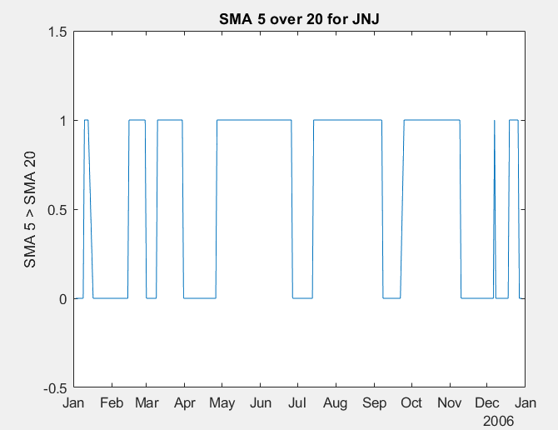
Simple Moving Average Crossover (SMA)
The SMA indicator uses 5-day and 20-day simple moving averages to make buy and sell decisions. When the 5-day SMA crosses the 20-day SMA (moving upwards), then the stock is bought. When the 5-day SMA crosses below the 20-day SMA, the stock is sold.
Indicator marks 1 for buy (5-day SMA > 20-day SMA) and 0 for sell (5-day SMA < 20-day SMA).

Slide 16
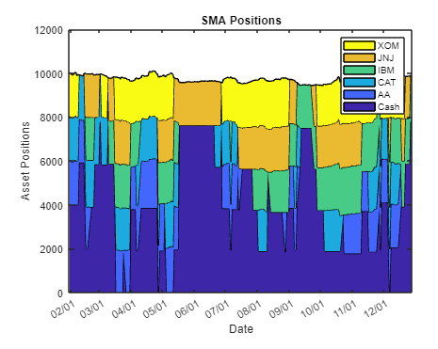
Simple Moving Average Crossover (SMA)
Trend-following strategy
Impacted by market volatility
Higher transaction costs
Cash as defensive position

Slide 17
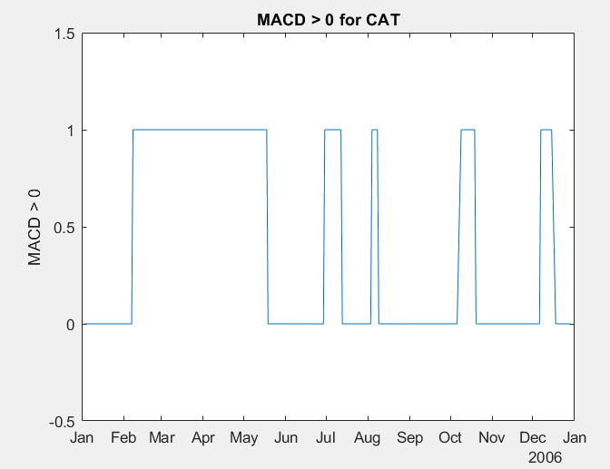
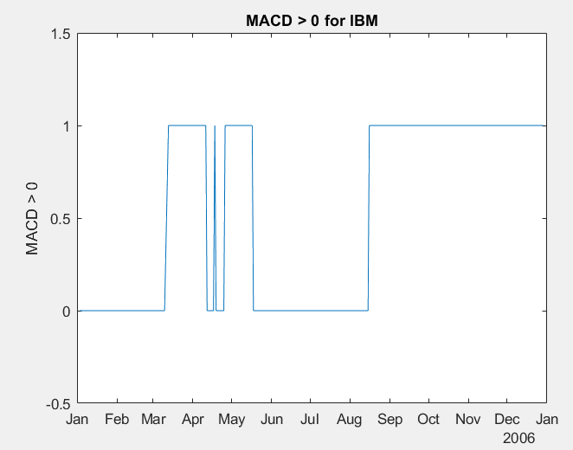
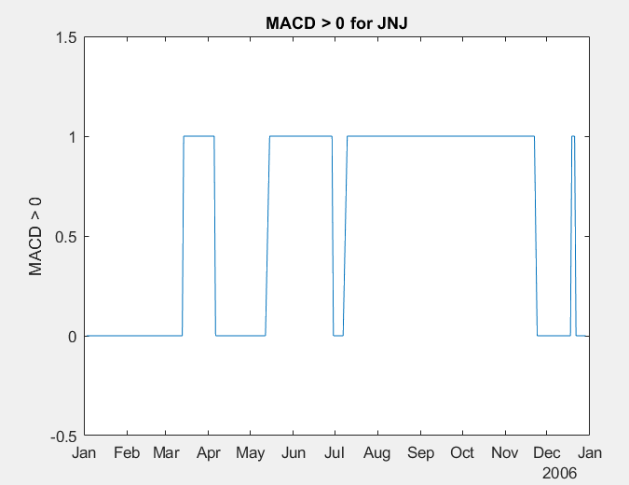
Moving Average Convergence/Divergence (MACD)
You can use the MACD metric in a variety of ways. Often, MACD is compared to its own exponential moving average, but for this example, MACD serves as a trigger for a buy signal when the MACD rises above 0. A position is sold when the MACD falls back below 0.
Each signal has a value of 1(buy) when the MACD of the stock is above 0. The signal has a value of 0 sell when the MACD of the stock falls below 0.

Slide 18
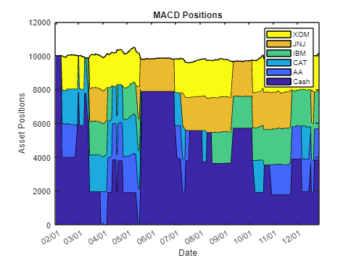
Moving Average Convergence/Divergence (MACD)
Based on medium-term trend signals
Cash as defensive position Sensitive to market trends
Fewer extreme fluctuations compared to SMA
Still high transaction costs
Risk on missing out quick gains on market

Slide 19
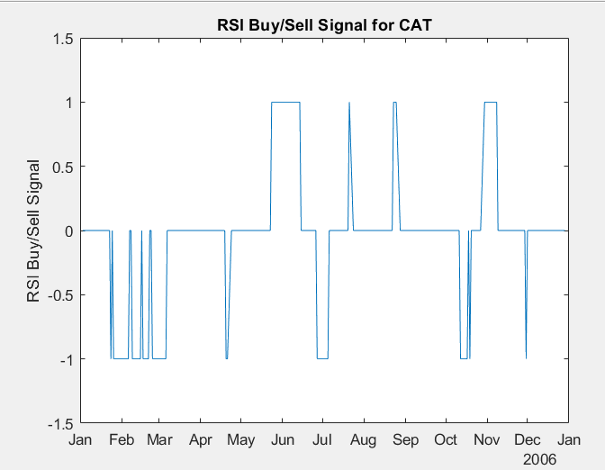
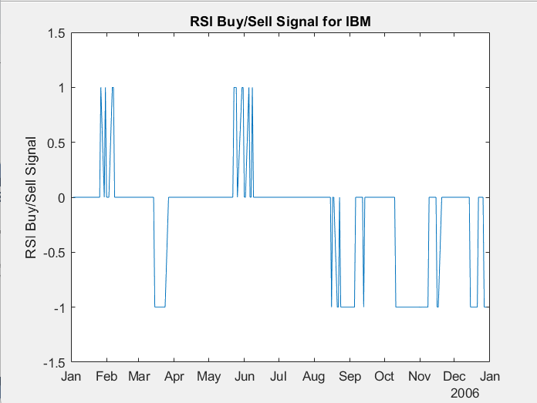
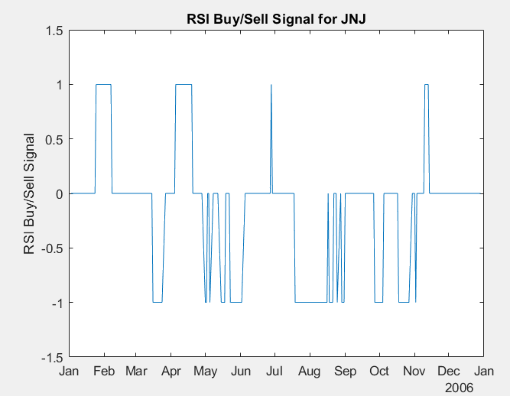
Relative Strength Index(RSI)
The RSI is a metric to capture momentum. A common heuristic is to buy when the RSI falls below 30 and to sell when the RSI rises above 70.
Window size is 14 days.
The RSI signal takes a value of 1 (indicating a buy signal) when the RSI value for the stock falls below 30. The signal takes a value of -1 (indicating a sell signal) when the RSI for the stock rises above 70. Otherwise, the signal takes a value of 0, indicating no action.

Slide 20
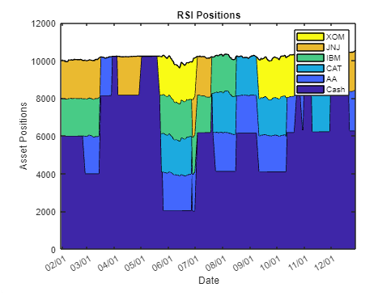
Relative Strength Index(RSI)
More sensitive to short-term fluctuations, because it reacts to recent price momentum
Highly sensitive to market volatility
More cash positions than SMA and MACD
Reduced drawdown potential
Less transaction costs

Slide 21
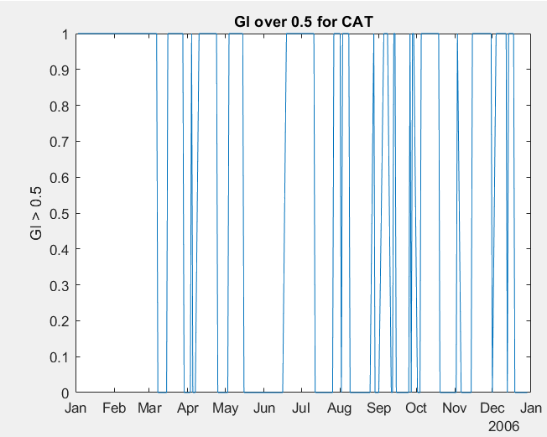
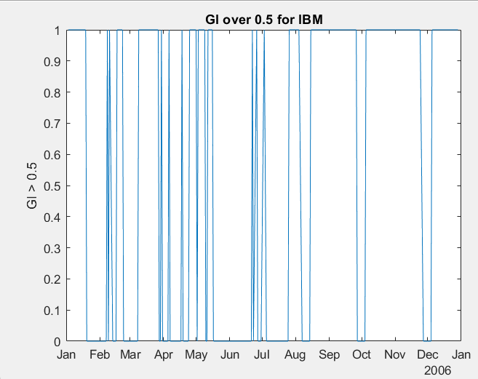
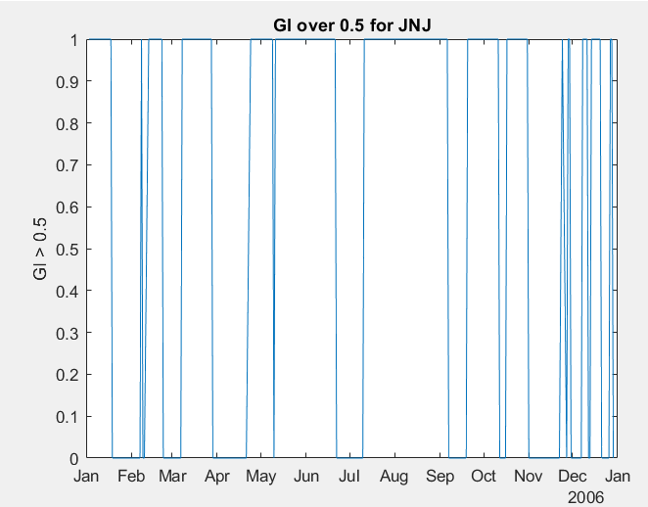
Goodness Indicator Index (GI Index)
The GI indicator uses Sharpe Ratio/sigma to make buy and sell decisions. When SR/sigma is above 0.5, then the stock is bought. When SR/sigma is below 0.5 the stock is sold.
The GI signal timetable contains an indicator with a value of 1 (buy) when SR/sigma is above 0.5, and a 0 (sell) otherwise.

Slide 22
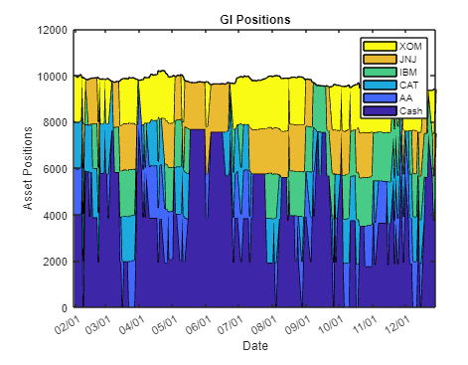
Goodness Indicator Index (GI Index)
Frequent adjustments
Sensitive to both price movements and volatility
High cash allocation in volatile periods
IBM and CAT shift more frequently, indicating that these stocks might have exhibited more fluctuating risk-adjusted performance
Frequent rebalancing
Offers a balanced approach between capturing returns from high-performing stocks and mitigating risk by maintaining flexibility to move to cash during uncertain times.

Slide 23
Backtest Results
Benchmark vs. Active Strategies: The benchmark consistently outperforms most of the active strategies, ending the year at a higher portfolio value. This suggests that in 2006, a passive approach outperformed the trend-following and momentum-based strategies, which experienced challenges with market volatility and false signals.
Performance of RSI Strategy: The RSI strategy stands out as the best-performing active strategy, indicating that its approach to balancing between overbought and oversold signals helped capture some gains while avoiding large drawdowns.
Underperformance of GI and SMA: The GI and SMA strategies struggled significantly, with GI ending the year with substantial losses. These strategies may have been poorly suited to the specific market conditions, particularly if the year involved frequent reversals and lacked sustained trends.

Slide 24
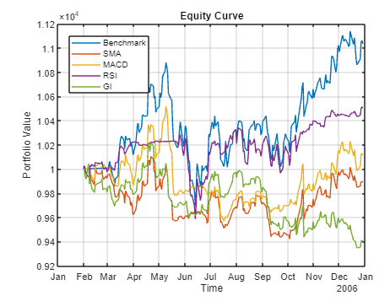
Result

Slide 25
Performance measures strategies
Strategy | Total Return | Mean Annual Return | Std Annual Return | Sharpe Ratio | p-value
Benchmark | 0.10338 | 0.11489 | 0.12307 | 0.93354 | 0
SMA | -0.010407 | -0.0076884 | 0.086421 | -0.088964 | 0.17766
MACD | 0.011095 | 0.015433 | 0.082506 | 0.18705 | 0.0048717
RSI | 0.050102 | 0.056719 | 0.082394 | 0.68839 | 0
GI | -0.060102 | -0064052 | 0.084433 | -0.75861 | 0

Slide 26
Conclusion
This backtest demonstrates that while the benchmark and RSI strategies achieved relatively stable performance, the other strategies, particularly SMA, MACD, and GI, faced difficulties with market timing
The benchmark's steady rise suggests that a passive, buy-and-hold strategy may have been more effective in 2006.
The RSI strategy’s ability to outperform other active strategies highlights its relative strength in managing volatility and avoiding market noise.
This analysis underscores the importance of aligning strategy selection with prevailing market conditions and transaction costs).

Slide 27
Thanks!
Do you have any questions?
Miguel Ángel González Álvarez
Emilly Noelia Villacís Recalde
Quinten Woumans
Edoardo Anfelli
Stokely Ross

